Slide 1

The New York City Housing Crisis: Navigating Rental Market Challenges
F D B

Slide 2

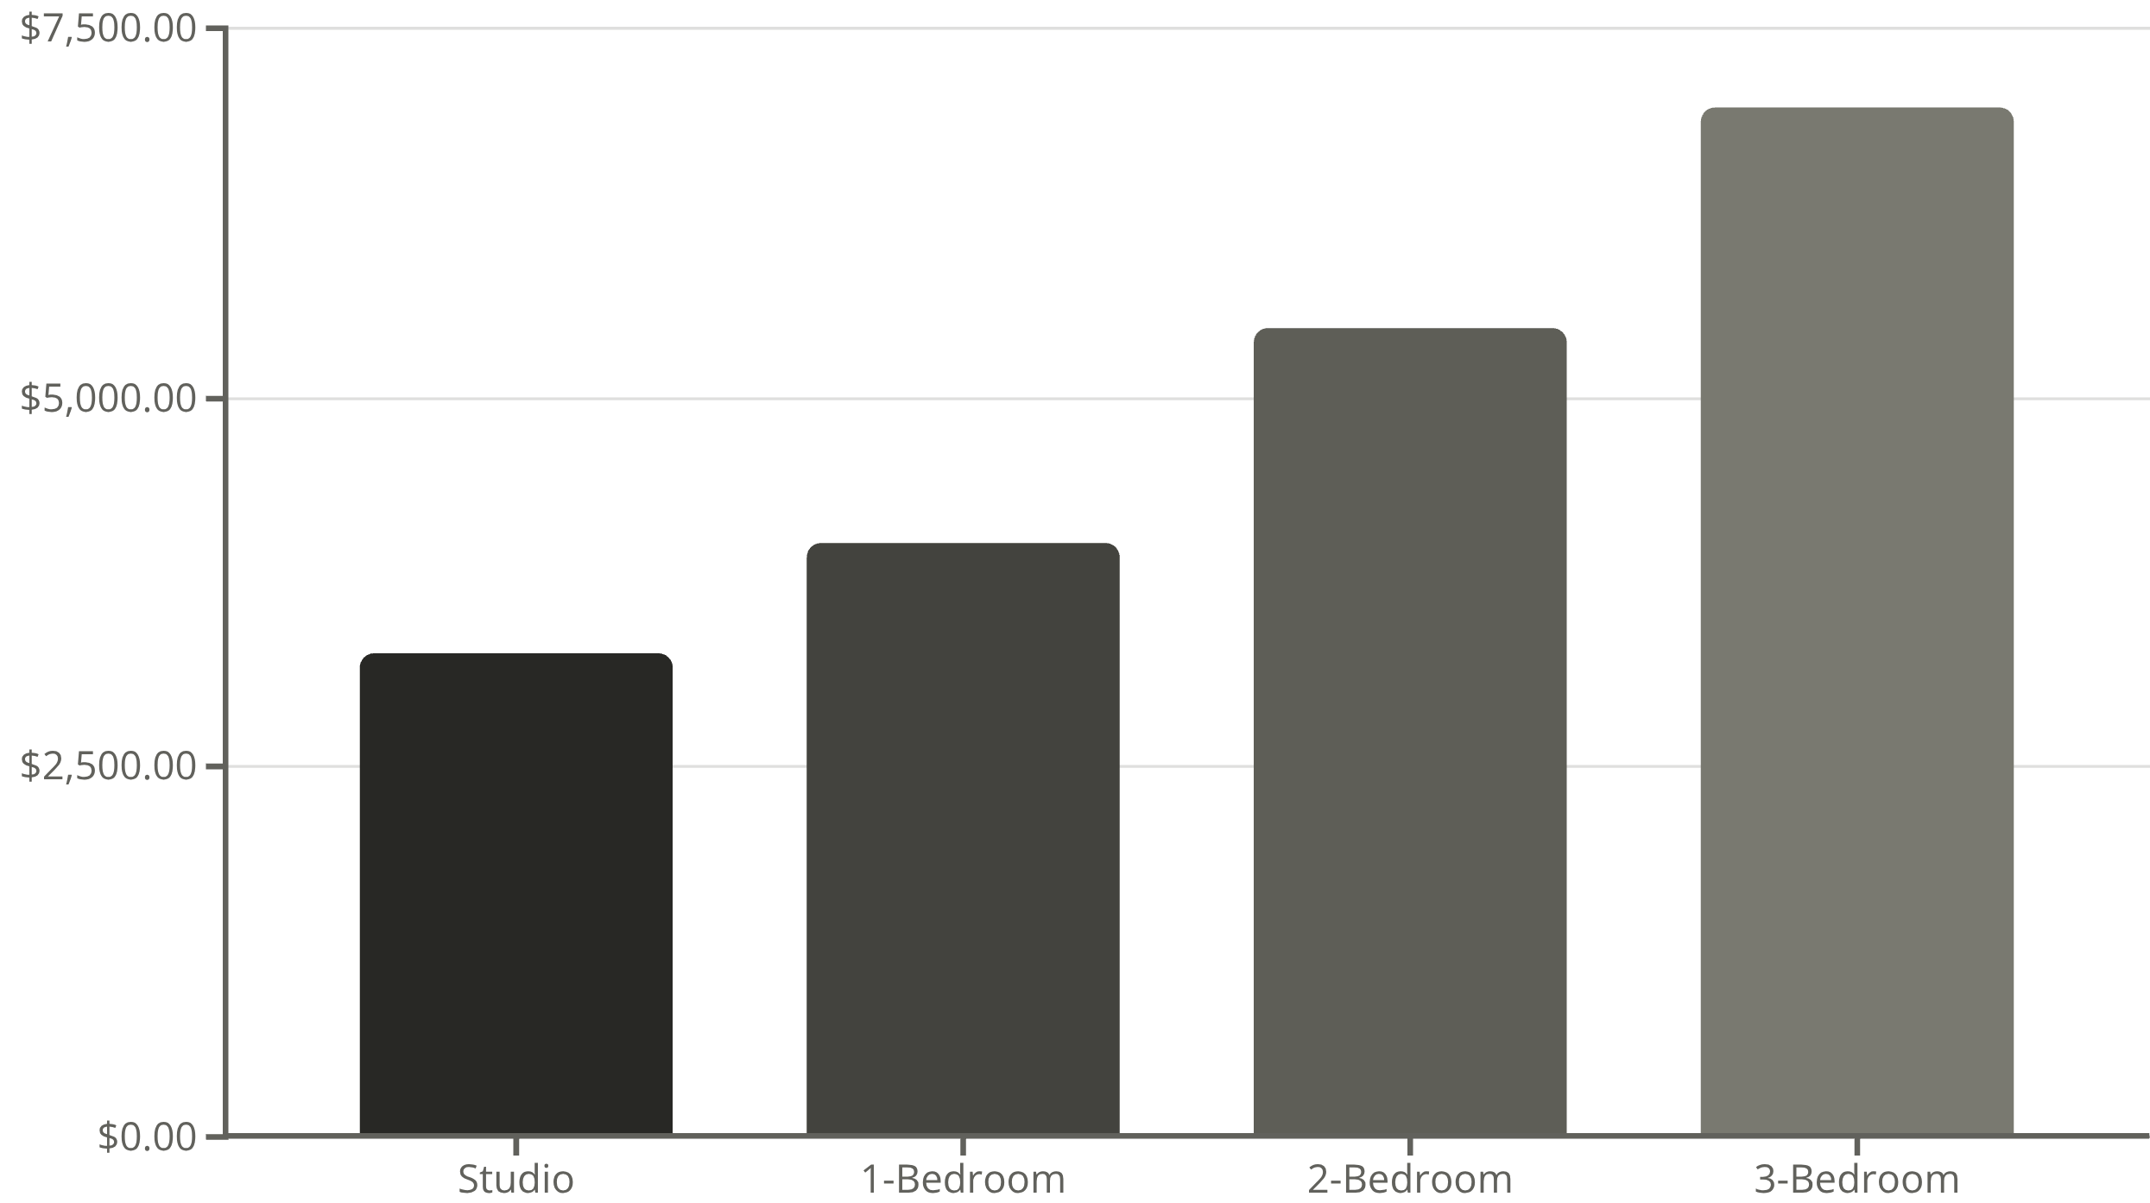
Average Monthly Rent by Apartment Size
100%
200%
Year-over-year increase
Above national average
Living in NYC means navigating a tough rental market. High prices, broker fees, and fierce competition make finding an affordable apartment challenging, especially in Manhattan

